Slide 1
Affordable Senior Housing in Brookline Mission and Role of Brookline’s Housing Advisory Board (HAB)
Presented to Livable Communities Advisory Committee (LCAC) Roger Blood – HAB Chair Emily DeHoog – Senior Housing Planner Ewana Lindo-Smith – Housing & Community Planning Director September 9, 2024

Slide 2
A 1987 Town Bylaw created Brookline’s current three-pronged approach to affordable housing
Inclusionary Zoning
Affordable Housing Trust
Housing Advisory Board (HAB)
These three elements interact to create and preserve affordable housing in Brookline
The Bylaw gives the HAB oversight responsibilities for Inclusionary Zoning and the Affordable Housing Trust

Slide 3
Housing Advisory Board
The mission of the Housing Advisory Board (HAB) is to promote the preservation and creation of housing that is affordable to low, moderate, and upper-moderate income households. The HAB:
Makes recommendations to the Planning Board on zoning matters relating to affordable housing, most notably the application of Affordable Housing requirements of the Zoning By-law to specific projects (“Inclusionary Zoning”).
Makes recommendations to the Select Board regarding housing-related funding, including Brookline’s Affordable Housing Trust and federal HOME and CDBG monies. HAB members are trustees of the Affordable Housing Trust.
Provides guidance on housing-related planning efforts such as the Housing Production Plan as well as site-specific housing plans that include affordable housing.
Holds public meetings and hearings and offers recommendations to Town Meeting on housing-related Warrant Articles.

Slide 4
Town Bylaw prescribes a ten-member Housing Advisory Board including targeted knowledge and lived experience
Seven Select Board-appointed members (2-year terms)
Development – Pam Goodman
Finance – Roger Blood
Development & Finance – Carol Gladstone
Legal – Jonathan Klein
Affordable Housing Renter – Rita McNally
Affordable Housing Renter – Shawn O’Neal
Affordable Housing Renter – Alex Krieger
Three member-seats appointed by other related Boards/Commissions
Select Board member – Required under MA Community Preservation Act (CPA) Bernard Greene – Select Board Chair
Planning Board member – Required under Town Bylaw Steve Heikin – Architecture/Design, Planning
Brookline Housing Authority Commissioner – Required under Town Bylaw Mike Jacobs – Affordable Housing Programs

Slide 5
Inclusionary Zoning (ByLaw Section 4.08) encourages the creation of affordable housing as a part of private market- rate housing projects. The current Bylaw requires:
Projects with more than 10 units - 15% of total units must be affordable and typically located within the project
Projects with 4 to 10 units have the option to make a cash contribution to the Town’s Affordable Housing Trust as alternative to onsite affordable units
On large projects the Town can negotiate a range of affordable housing plans if a more favorable housing outcome can be realized vs. bylaw minimums

Slide 6
To date, Inclusionary Zoning has produced over 100 onsite affordable units in more than 20 projects
51 affordable condominium units in 13 projects
21 affordable rental units in seven projects
17 affordable assisted living units in one project
15 affordable SRO (lodging house) units in one project
Currently the Town has 15 additional Inclusionary Zoning Projects approved or under review which will contribute about $8 million into the Affordable Housing Trust over the next few years

Slide 7
The Affordable Housing Trust provides predevelopment and long-term funding for affordable housing projects in Brookline
Affordable Housing Trust funding typically complements other public and private, state and federal funding sources
The Town uses Trust Funds to support qualified project sponsors The Town does not itself develop or own affordable housing
Over $500,000 in total subsidies is currently needed to produce one affordable unit in Brookline
The average Trust Fund cost to produce an affordable unit since 2000 has been about $70,000. The current Trust Fund cost per unit is much higher.

Slide 8
Since 2000 Brookline’s Affordable Housing Trust has received over $32 million
Main sources of funds for the Affordable Housing Trust:
Housing developers - $22.6 million
“Free Cash” contributions from the Town - $8.4 million
Interest - $1.6 million

Slide 9
Total number of affordable units currently built and occupied in Brookline
Type of Affordable Housing No. of Units
Brookline Housing Authority (BHA) 895
Owned by Private Investors 431
Non-profit owner-sponsor 628
Affordable condominiums 152
Total Affordable Units: 2,106
* Note: This number is for actual, constructed affordable units serving households earning up to 110% area median income and differs from the Subsidized Housing Inventory (SHI) number which includes some permitted units that are not constructed as well as market-rate units in rental projects that are at least 25% affordable.

Slide 10
Since 2000 the Housing Trust has committed over $26 million to create and preserve affordable housing in these projects
100 Center & 1550 Beacon Street: $1 million
St. Aidans: $3.8 million
Olmsted Hill: $820,000
Dummer Street (BHA): $2.0 million
51-57 Beals Street: $830,000
370 Harvard Street: $1.5 million
90 Longwood Avenue (BHA): $897,000
32 Marion Street (BHA): $6.525 million (under construction)
108 Centre Street: $1.9 million (under construction)
Walnut-High Street (BHA): $7.5 million committed (50% from CPA)
NOTE: these figures do not include Town commitments of Federal HOME & CDBG funds

Slide 11
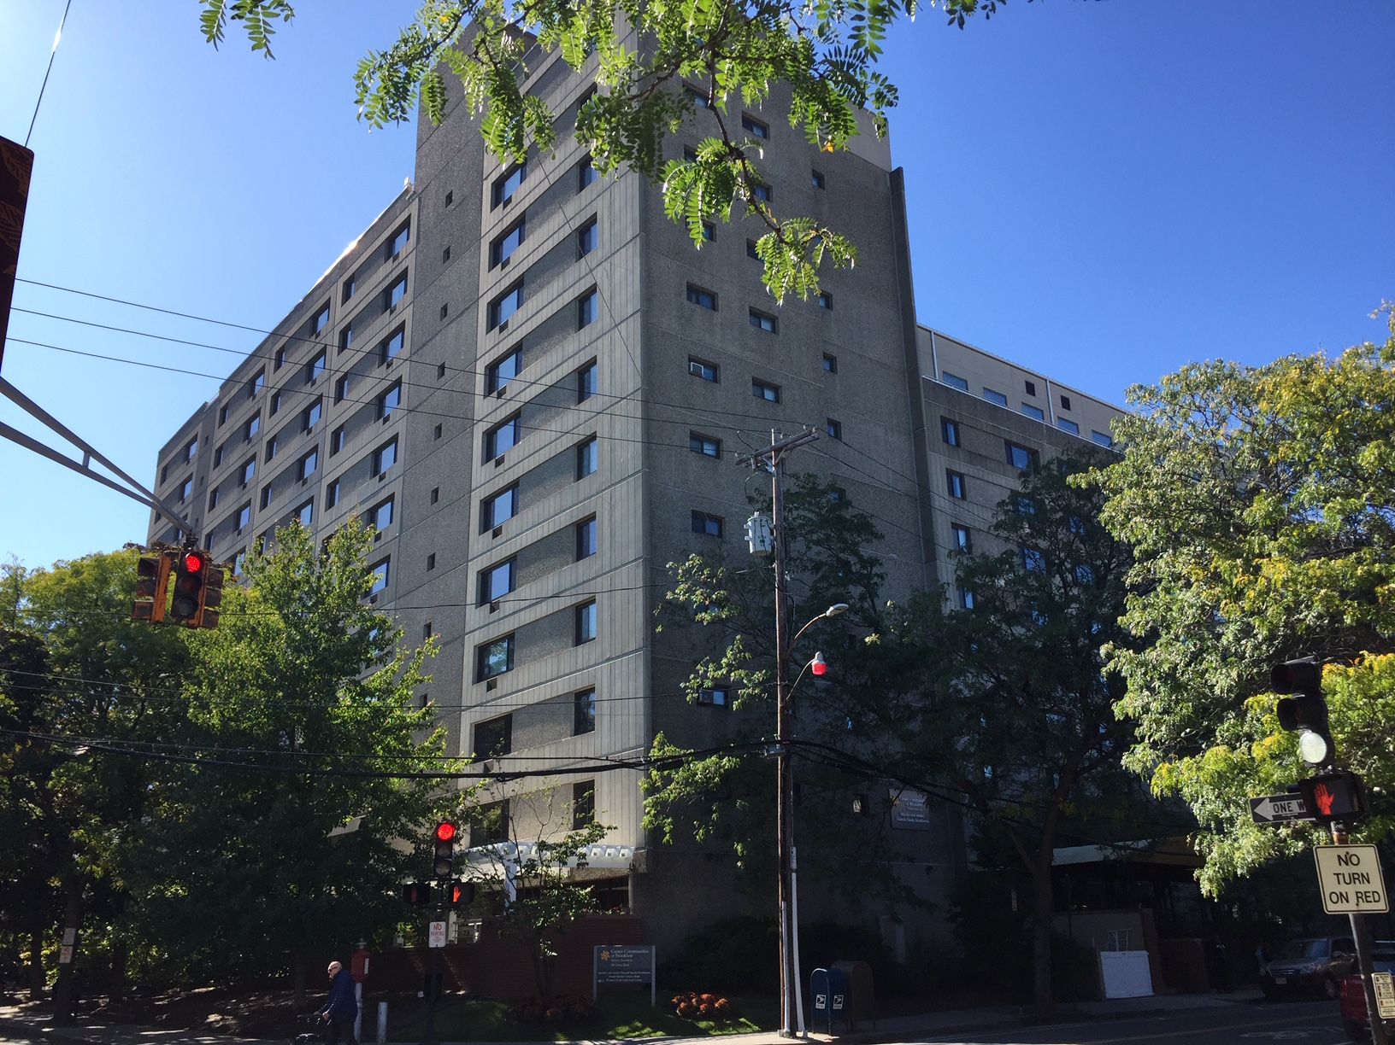
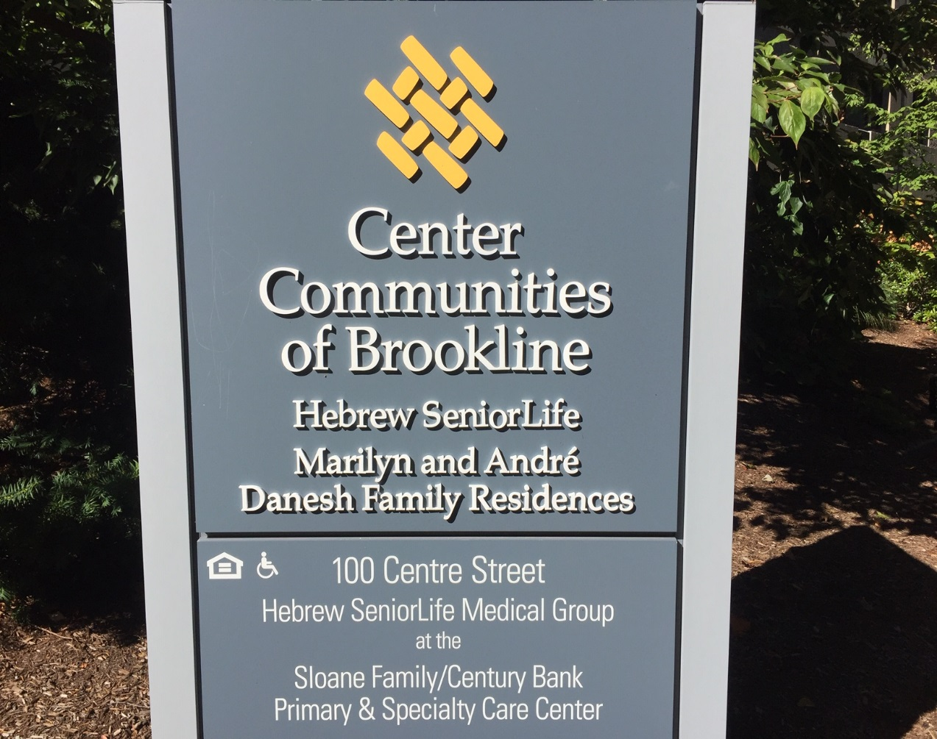
100 Center Street – Hebrew Senior Life Preservation of affordable rentals in “expiring use” building

Slide 12
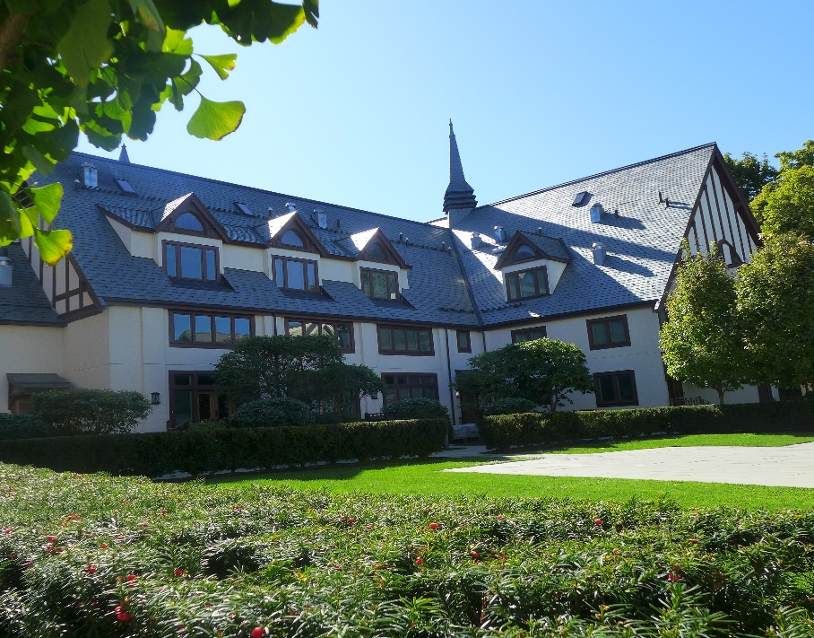
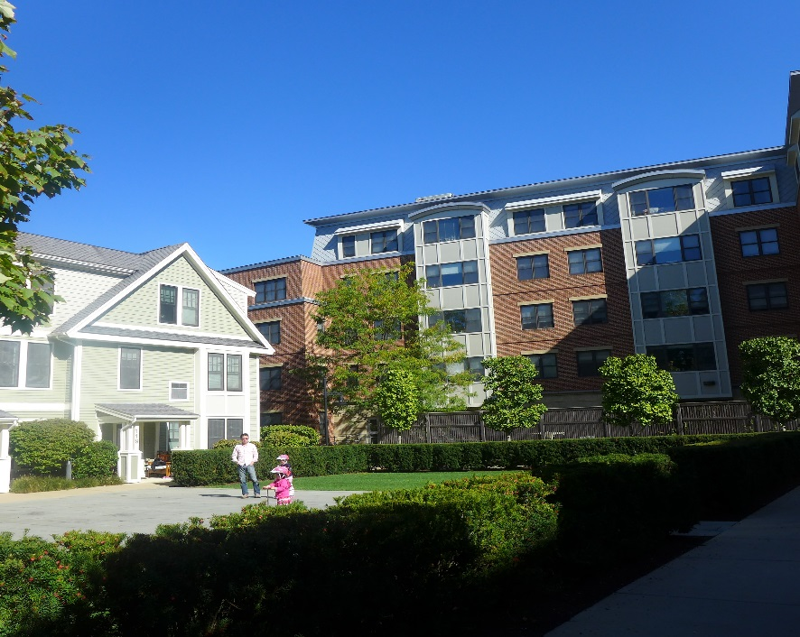
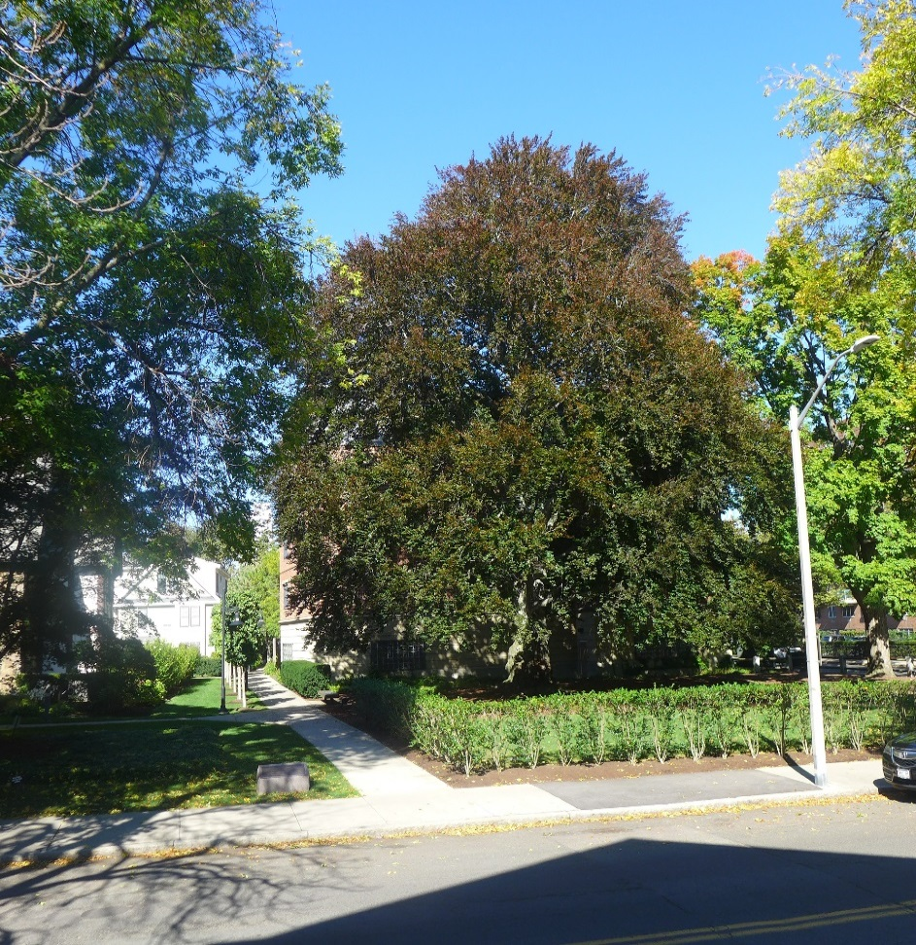
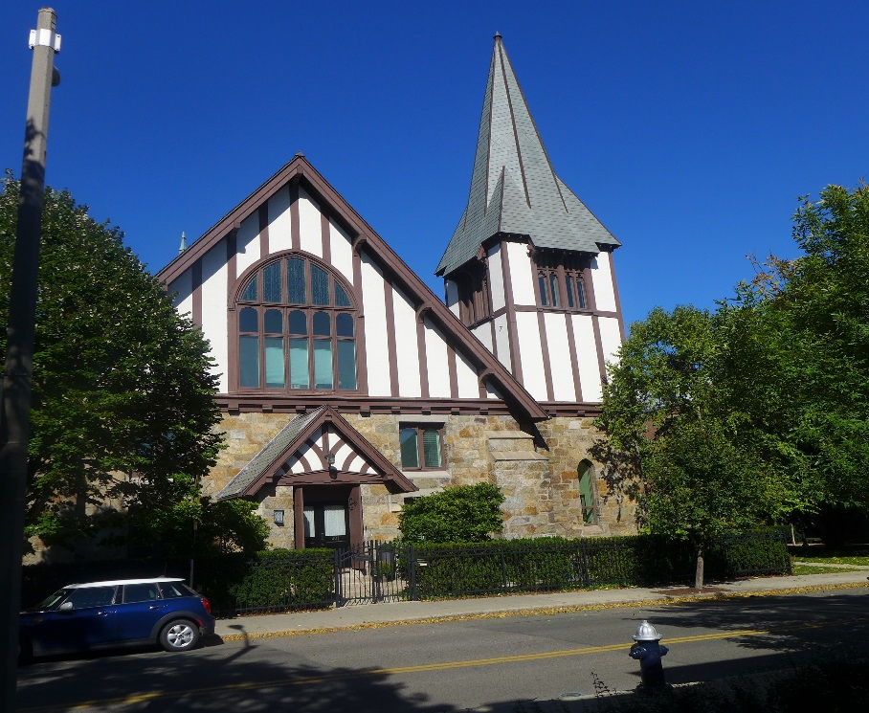
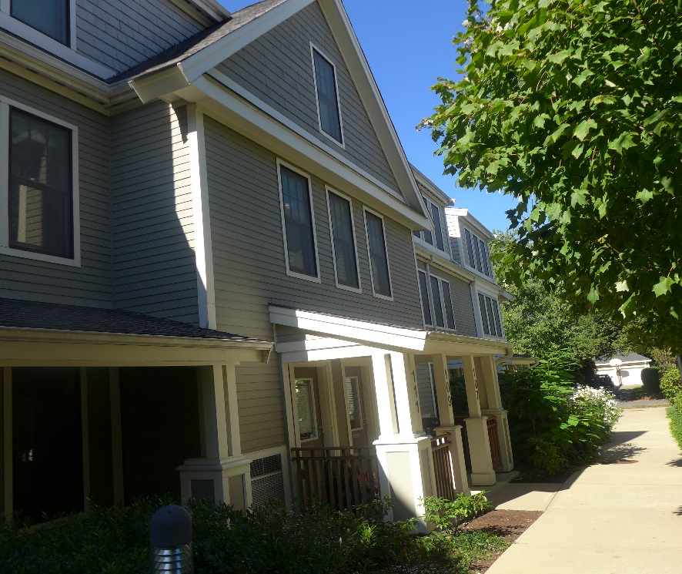
St. Aidans – Planning Office for Urban Affairs (POUA) 44 mixed-income affordable rental and condominium units

Slide 13
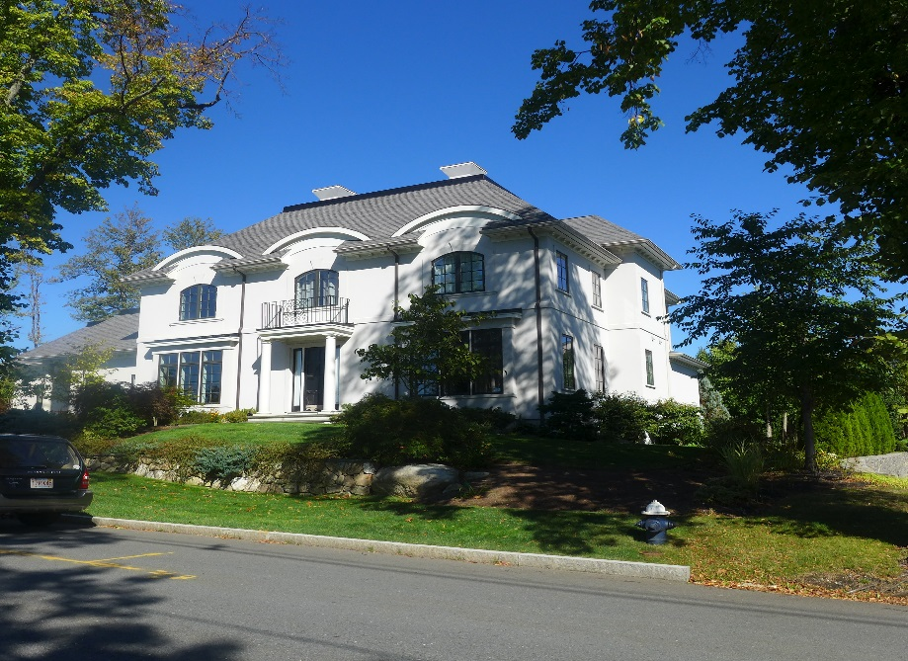
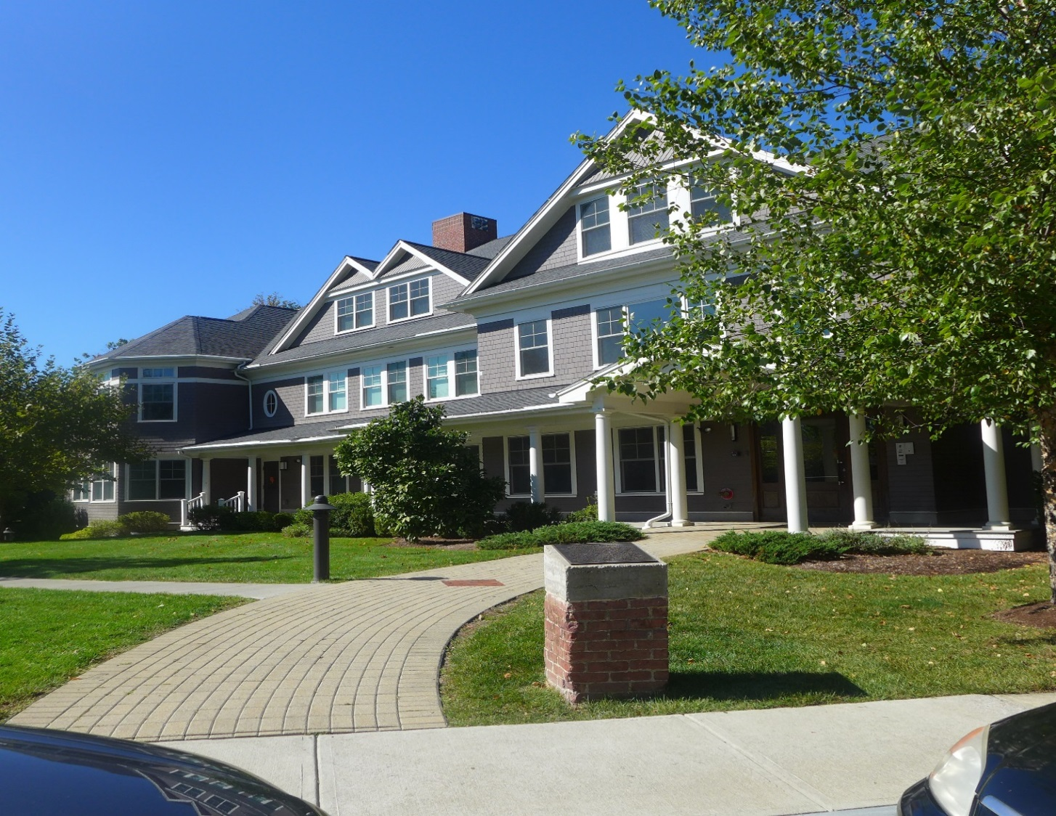
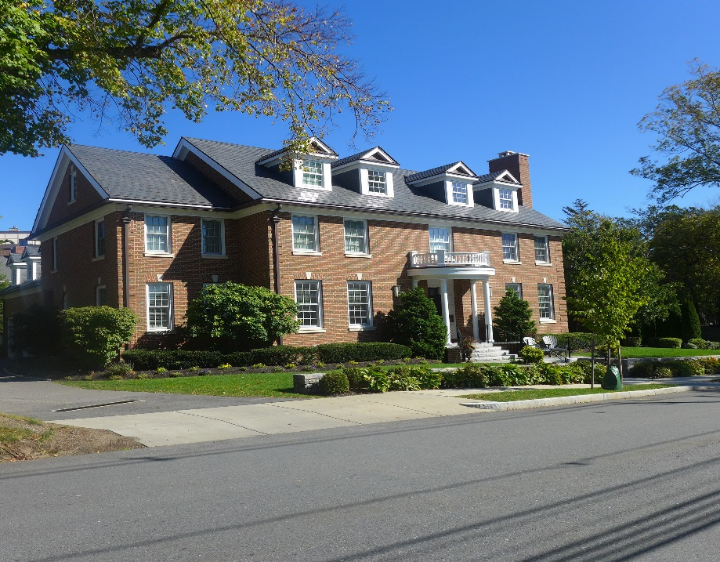
Olmsted Hill – New Atlantic Development 24 moderate and middle income condominiums

Slide 14
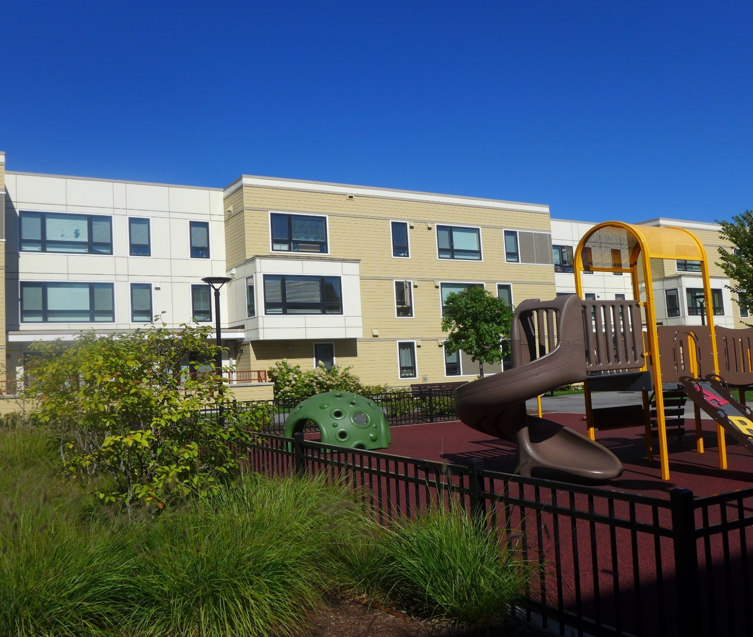
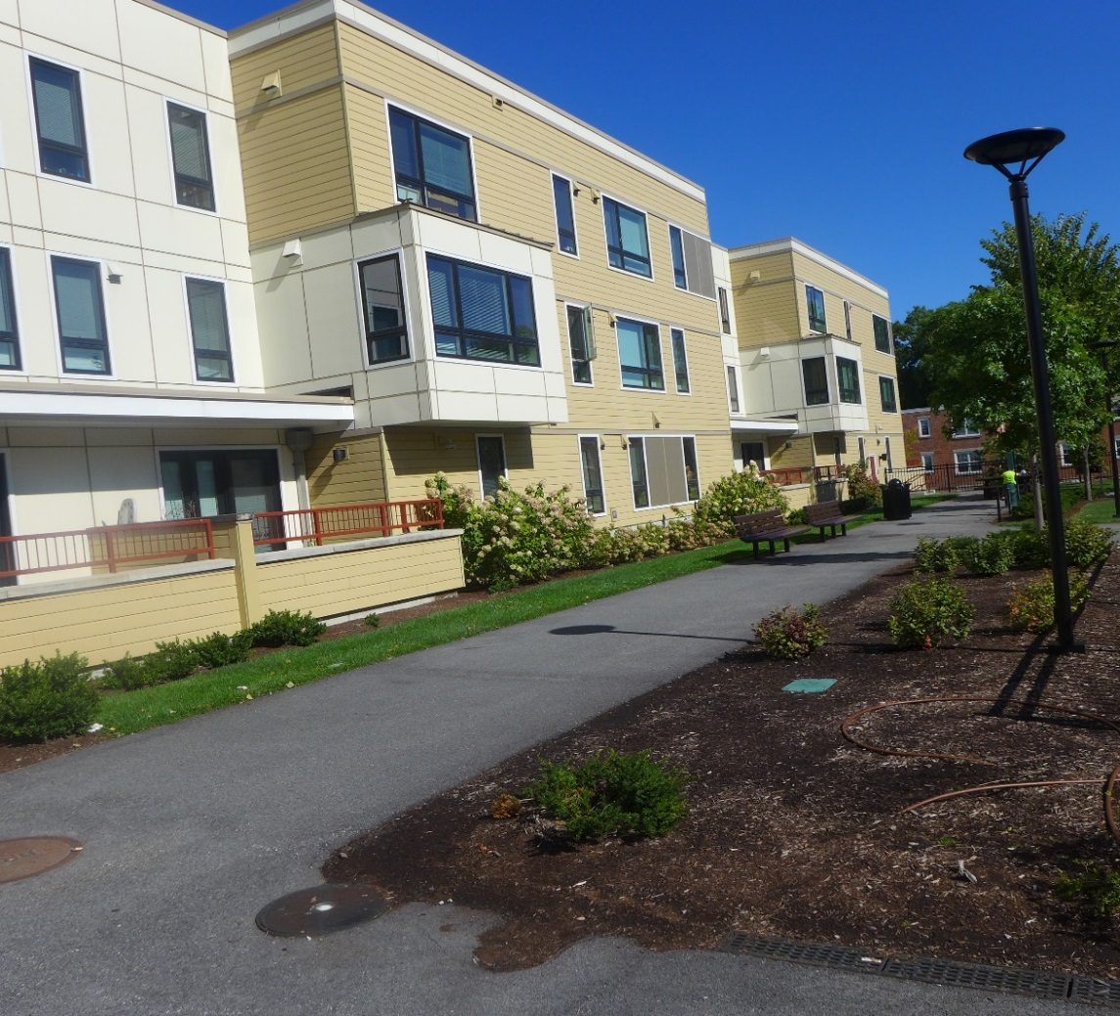
Dummer Street – Brookline Housing Authority 32 lower-income rental units

Slide 15
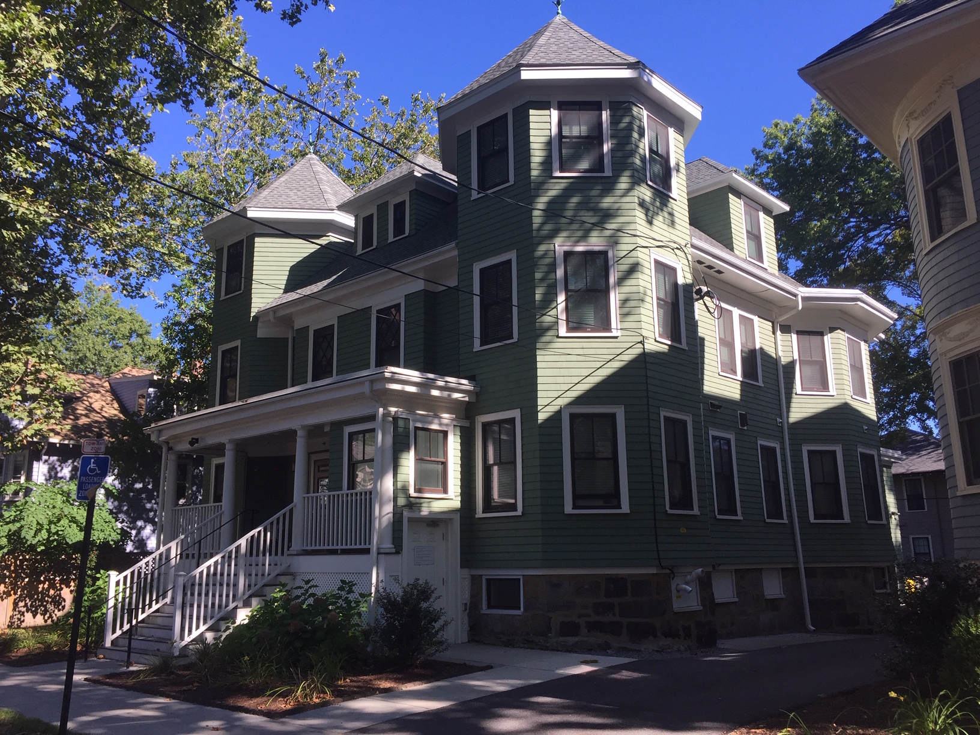
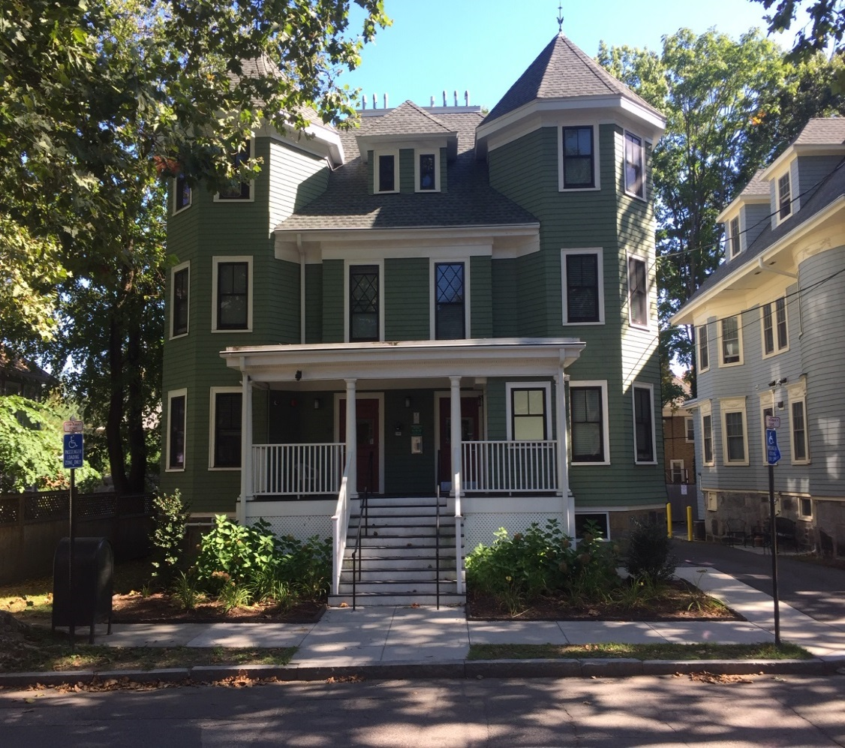
51-57 Beals Street – Pine Street Inn 31 low-income lodging house (SRO) units

Slide 16
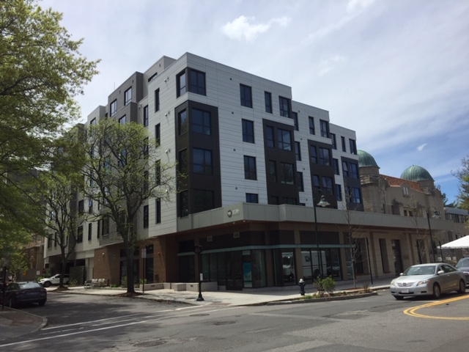
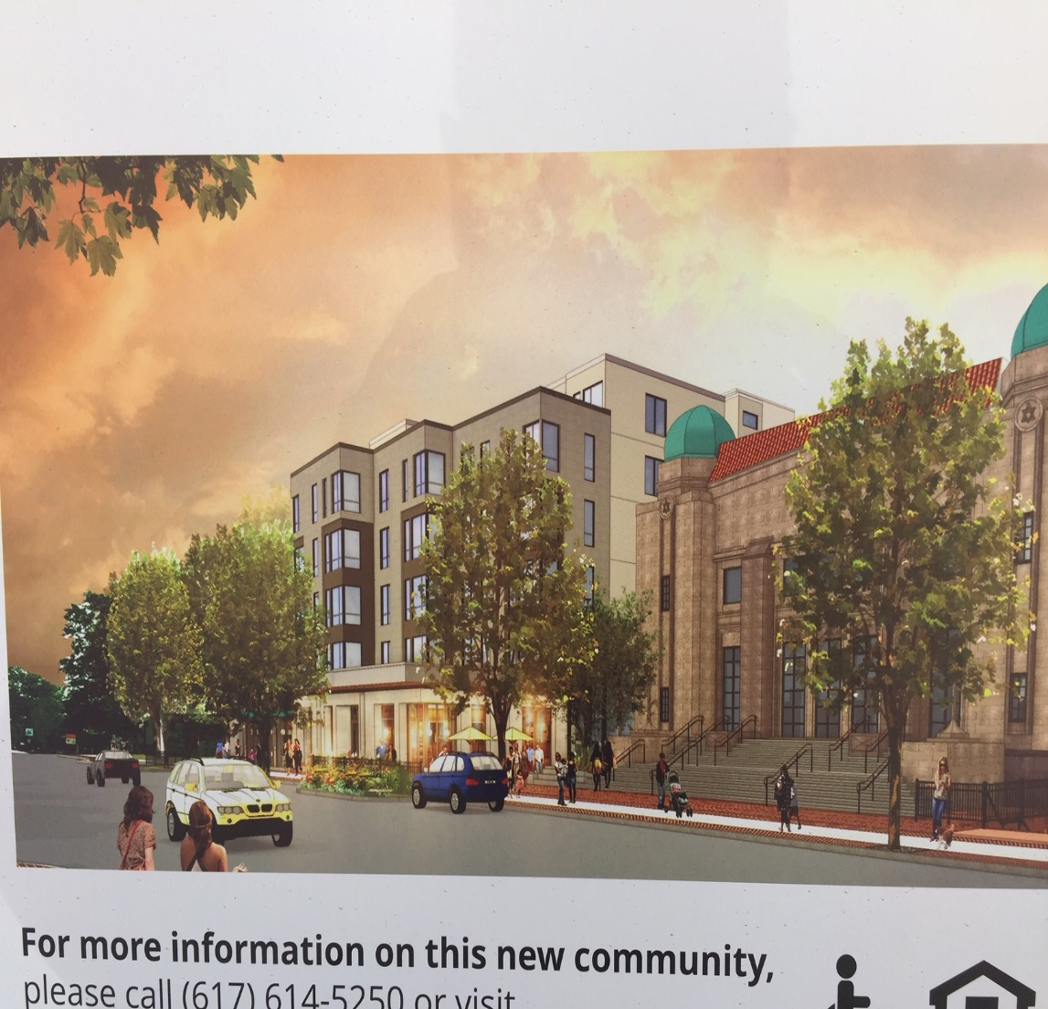
370 Harvard Street – 2Life Communities 62 senior affordable rental housing units

Slide 17
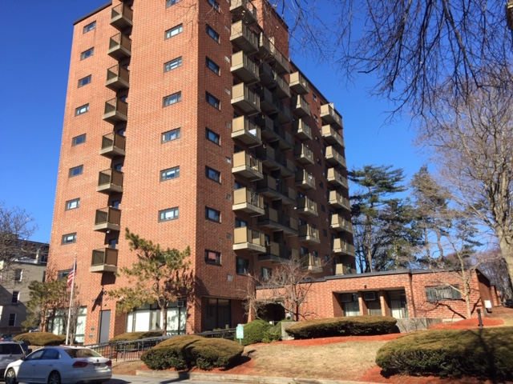
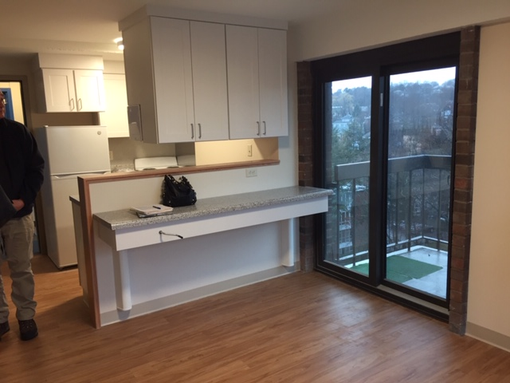
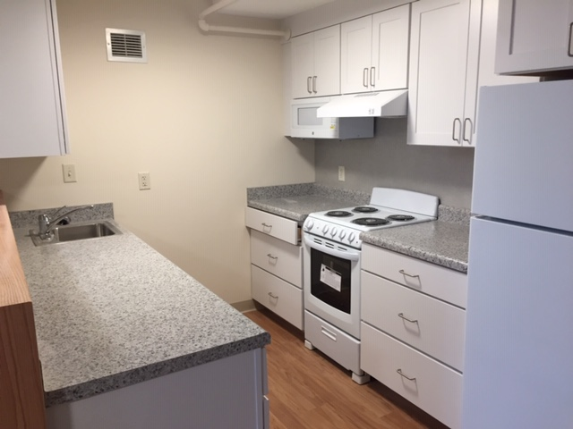
90 Longwood Avenue—Brookline Housing Authority (BHA) Substantial renovation of 99 low-income apartments for seniors and people with disabilities

Slide 18
Three Brookline Affordable Housing projects now in development with Trust Fund support
108 Centre Street Senior Housing
32 Marion Street Senior Housing
Walnut-High Apartments

Slide 19
108 Centre Street Senior Housing
Sponsor: Centre Communities of Brookline/Hebrew SeniorLife
54 new one-bedroom senior supportive rental housing units
Adjacent to Brookline Senior Center
Project is under construction; expected occupancy 2025
Supported by $1.9 million from the Town’s Affordable Housing Trust

Slide 20
32 Marion Street (Previously Col. Floyd Apts.)
Sponsor: Brookline Housing Authority (BHA)
115 new low-income senior rental housing units - replacing 60 obsolete walk-up senior housing units
Project is under construction; expected occupancy 2026
Supported by $6.5 million from Town’s Affordable Housing Trust
Source of earmarked Trust fund contribution: Negotiated Inclusionary Zoning payment by developer of The Newbury continuing care project

Slide 21
Walnut-High Apartments
Sponsor: Brookline Housing Authority (BHA)
96 new low-income rental housing units – replacing 24 obsolete walk-up senior housing units and 8 obsolete four-bedroom family townhouse units
Project is in final planning & design phase; expected completion 2028
Supported by $7.5 million from the Town’s Affordable Housing Trust (including 50% CPA funds)

Slide 22
Affordable Housing Lotteries in Brookline
Brookline affordable housing lotteries include:
Private multifamily developments subject to Inclusionary Zoning
Chapter 40B housing projects
Affordable housing sponsored by non-profit housing developers
Includes both rental and owner-occupied affordable housing
Lotteries’ “Local Preference” percentage was reduced from 70% to 25% in 2020
NOTE: Brookline Housing Authority projects operate under different tenant selection rules and do not participate in Brookline’s affordable housing lotteries

Slide 23
Questions?

